Slide 1
杭州原文

Slide 2
我记得那天很冷，很灰暗，下着小雨，雨下得很慢，但不停。父亲默默地开着车。没有人说话，我们所能听到的只有湿漉漉的路面上轮胎的声音。
I remember the day was cold and grey，with a light rain falling slowly but constantly. My father drove in silence. No one spoke and all we could hear was the sound of the tyres on the wet road.
我走开了，陷入了自己的沉思。
I wandered away, lost in my private thoughts.

Slide 3
我走到海边，海浪懒洋洋地拍打着泥泞的沙滩。突然，我看见一个绿色的东西伸出水面。我更仔细地看了看。那个绿色的东西离海岸越来越近，当它快到我能摸到的时候，我才意识到它是什么
I walked down to the seashore, where the waves were breaking lazily against the muddy sand. Suddenly, I saw something green sticking out of the water. I looked at it more carefully. The green thing moved closer and closer to the shore, and when it was almost near enough for me to touch, I realized what it was.

Slide 4
那是一个瓶子。我走过去把它捡起来，一直看着它。我慢慢地把瓶盖上的湿软木塞拔了出来。里面有一张纸。我小心翼翼地拿出那张折叠好的纸，打开它。上面写着这样的话:
"无论谁找到这瓶酒，我保证给你交个新朋友"
It was a bottle. I went over and picked it up, all the time looking at it. ... Slowly, I pulled out the wet cork from the top of the bottle. Inside was a piece of paper. With great care, I took out the folded paper and opened it.
Written on it were these words:
“To whomsoever finds this bottle, I promise you a new friend.”

Slide 5
1.I moved to the Nethelands not knowing 不认识anyone except my husband, not knowing how to speak the language, and leaving (leave)behind my friends, family and everything I knew that represented me.
2.At first, sounds of vague meanings coupled (couple) with hand geatures was on our way of having a conversation.
3.It wasn’t until 直到 I disovered she was a choral director for a women’s group in the community that we then began communicating on a whole different level.
4.And then by chance, I came across a TED-talk featuring 主要关于you, Mr. Whitacre discussing your music and the virtual choir.
她越来越焦虑,恐慌,病倒了。
She collapsed because of increasing anxiety coupled with
panic.

Slide 6
暨阳续写

Slide 7
Ben被一声枪响惊醒。尖锐的声音穿过房子的厚石墙传来。卧室里.很冷，Ben下床时浑身发抖...田野上覆盖着白霜
Ben was awakened by a gunshot. The sharp noise came through the thick stone walls of the house. It was cold in the bedroom and Ben was shaking as he got out of bed...The field was covered with white frost.
突然一只鸟飞了起来。那人迅速把枪扛在肩上开了一枪。Ben看着那只鸟，祈祷它没有受伤。它飞到离地面很近的地方，钻进了高高的草丛里。
Suddenly a bird flew upward. The man quickly put the gun to his shoulder and shot. Ben watched the bird, praying it had not been hurt. It flew near the ground and went into some tall grass.

Slide 8
Ben心中恨极了着猎人。他的声音划破了寂静。猎人停了下来，但继续跟着那只鸟。
Hate for the hunter burned inside of Ben. .. His voice cut through the stillness. The hunter stopped, but then continued to follow the bird.

Slide 9
续写时注意一些文化上的gaps
嘉兴续写 “hit the botton”
即使时strangers，互动时的礼节

Slide 10
暨阳续写：
主题：这是一个关于保护鸟类的故事，是在人与自然的主题语境下的一个故事；人与人之间的矛盾和处理
在该材料中有一个比较明显的中西文化差异，就是对于自身的财产和领地的保护。在西方文化中，私有领地神圣不可侵犯，而猎人用枪打鸟也是天经地义，当这两个都认为自己所坚持的信念和所做的事是理所当然的时候，那么冲突自然在所难免了。如果无法意识到这一点，忽略到这个文化内涵，则后续的故事冲突便很难写精彩。
续写不仅考查学生的语言水平，还考查学生的思维素质，学生的逻辑思维、发散思维以及创新思维。基于主题的故事情节发展很重要，语言更是重中之重，这篇续写包容性很大，言之有理能够自圆其说的结尾都是可以的。原文最后一句he wanted to surprise the hunter，若考生能够围绕此点展开故事情节，能用精妙的语言去描写刻画，言之有物，言之有理，肯定是一篇新高考续写要求的好文章。

Slide 11
Paragraph 1:
Suddenly he heard a bird’s wings beating the dry grass. Ben moved quickly toward the sound and saw a colored head of a beautiful bird. The bird did not move until Ben came close. Then it tried to fly away, but one wing was broken. Ben lifted the bird and held it close against his body. The bird fought to escape, but soon lay quietly in Ben’s arms. Ben decided to take the bird home and fix its broken wings so that it could fly again. He was almost through the woods when he heard the hunter behind him. “It is mine!”

Slide 12
Paragraph 2:
There was something threatening in the man’s cool quiet voice. The hunter stepped closer and said, “Give me that bird!” Ben was frightened at first. However, when he saw the bird struggling weakly and made a wild, strange noise, he knew he could never give this bird to the hunter. This feeling gave Ben great strength, and he was no longer afraid. “This is my property. Leave here, or I call police!” Ben said assertively（果断地）. The woods were strangely quiet. To Ben’s surprise, the hunter slowly walked away. Ben carefully studied the injured wing. He stayed with the bird, smoothing its feathers, delighted to see it recovering slowly .

Slide 13
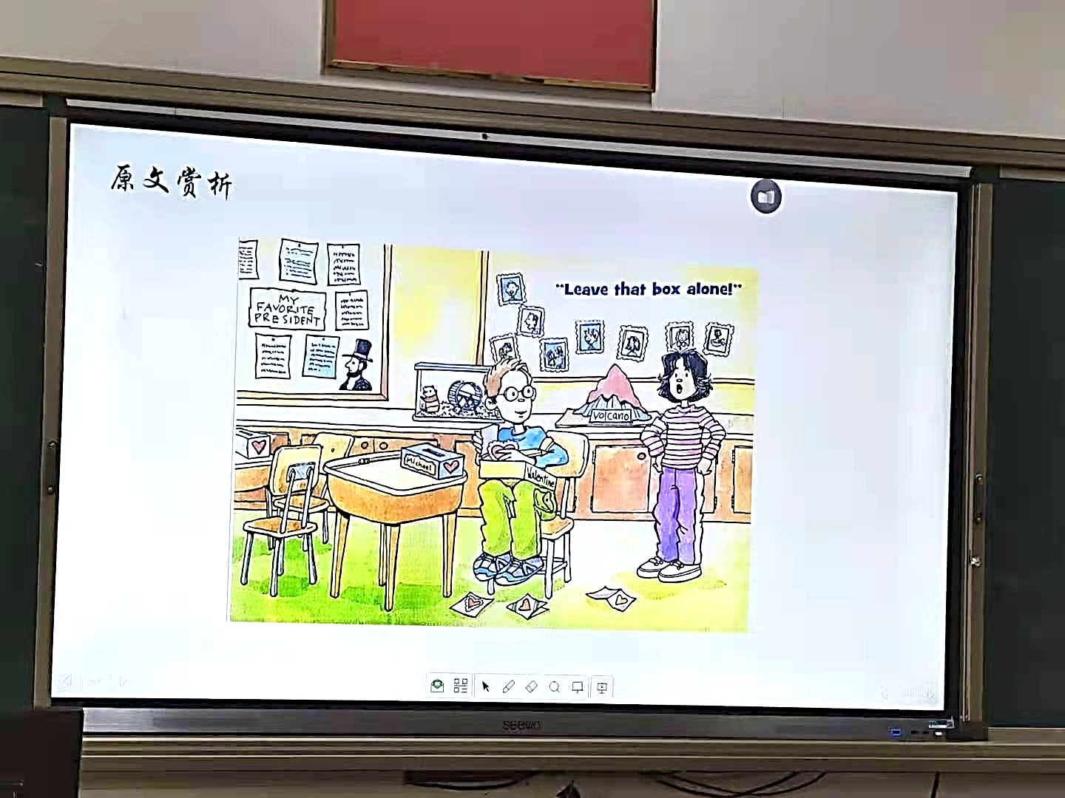

A Valentine’s trick

Slide 14

绍兴二模续写主要问题
缺乏主题意识（（Peterson wasn’t as bad a boy as I thought of;)主题没有得到很好地传达
没有按照主题有效设计情节；情节发展逻辑性不够严密，或与原文情节融洽度不高；与段首句的协同不够（what I heard)；
文化差异
不了解Valentine’s Day 的真正含义;没有注意到中外名字的表达差异given/first name + family name（Michael Peterson; Michael Rogers) ；没有了解国外break 期间教室一般没人；

Slide 15

Valentine's Day
Valentine's Day is a special day of love!
It is a day to celebrate friendship and love.
It is a time to give little gifts to special people
It is a day to make handmade valentine cards for your family and friends.
It is a time to share a story and a smile with
someone you like.

Slide 16
5月份复习：
冲刺作文
关注续写原文
熟记诵读各类续写片段
熟记诵读各类应用文
拿下95
错误归类（难点；易错）
词汇（选修6，7词汇过关）
（书写）

Slide 17
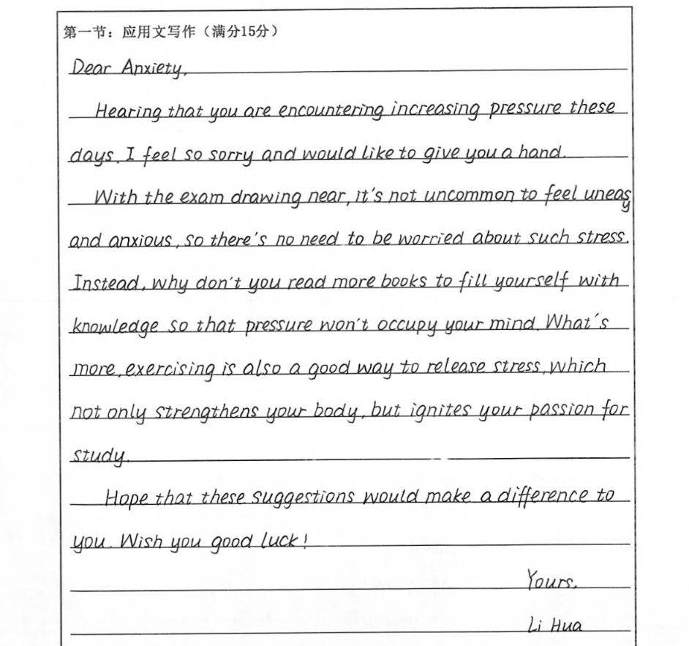

Slide 18
Para1 Suddenly he heard a bird’s wings beating the dry grass. Ben took a deep breath. “Without doubt,” he thought, “the bird exposed its spot to the human predator who was watching over these grass land.” Just at the very moment when the hunter was targeting the bird and was about to trigger, Ben shouted at the top of his voice “Stop!” It startled both the bird and the hunter – the bird soared up to the sky and the man abruptly put down the gun. He sternly turned around toward the direction where Ben stood, “Who are you doing here ?”

Slide 19
Para2 There was something threatening in the man’s cool quiet voice. Ben straightened his back and replied the intruder’s confrontation(对峙；对抗） with as much determination and assurance as he could summon up or fake, “I am the landlord of this place and you step into my private property. I demand you leave right now.” “Is that so?” The hunter gave a snort of contempt（轻蔑）. “Yes, I have claimed this property! LEAVE!” The hunter swung his gun and whistled, leaving at last. Ben relieved a sigh. The frost on the dry grass started to melt when the rising sun popped out from the east with sunlight dancing on the signs “No hunting”.

